Slide 1
Employee Data Analysis using Excel
STUDENT NAME: R. Krishna Kumar
REGISTER NO: 312203248, 08D192F3F44EDD683FF45F96AF7D6C5A
DEPARTMENT: B.Com (gen)
COLLEGE: Prince Shri Venkateshwara Arts
And Science College

Slide 2
PROJECT TITLE
Employee Salary And Compensation Analysis using Excel

Slide 3


AGENDA
Problem Statement
Project Overview
End Users
Our Solution and Proposition
Dataset Description
Modelling Approach
Results and Discussion
Conclusion
3/21/2024 Annual Review

Slide 4

PROBLEM STATEMENT
Inequitable pay practices
High turnover rates
Difficulty in attracting and retaining top talent
Inefficient use of budget resources
Analyze current salary and compensation datato identify trends, disparities, and areas for improvement
Develop a data-driven approach to optimize salary and compensation packages
Inform HR satrategies and budget decisions to enhance employee satisfaction, retention, and organizational performance

Slide 5

PROJECT OVERVIEW
To analyze and optimize and salary and compenstion package
Collect and analyze salary data, identify trends and disparitie and develop recommendations for improvement
Data analysis report, Excel models, and presentation summarizing findings

Slide 6

WHO ARE THE END USERS?
HR Managers
Finance Managers
Business Leaders
Compensation Analysts
Decision-Makers

Slide 7

OUR SOLUTION AND ITS VALUE PROPOSITION
SOLUTION:
Data-driven salary and compensation analysis
Customized Excel models for simulation and forecasting
Insights into market trends and internal equity
Recommedations for optimization and improvement

Slide 8
OUR SOLUTION AND ITS VALUE PROPOSITION
PROPOSITION:
Maximize budget efficiency
Enhance employee satisfaction and retention
Inform strateagic decisions with data-driven insights
Stay competitive in the market
Optimize salary and compensation packages for business success

Slide 9

Dataset Description
Employee ID, Name, Job Title, Department, Salary and Bonus
Salary ranges, Bonus structure are the important inforamation
Total Compensation, Deduction data`s are useful to find employee data`s

Slide 10

THE "WOW" IN OUR SOLUTION
SALARY AND COMPENSATION =SUM(E2:F2) and =G2-H2
3/21/2024 Annual Review
10

Slide 11
MODELLING
1. DATA CLEANING AND PREPARATION:
Organize and format data for analysis
2. DESCRIPTIVE ANALYTICS:
Calculate means, medians, and standard deviations to understand salary and compensation distribution
3. INDERENTIAL ANALYTICS:
Conduct regression analysis to identify factors influencing salary and compensation
4. PREDICTIVE MODELLING:
Develop Excel models to forecast salary and compensation ranges
5. SCENARIO ANALYSIS:
Simulate different scenarios to inform strategic decisions
6. OPTIMIZATION:
Identify opportunities to optimize salary and compensation packages
11

Slide 12
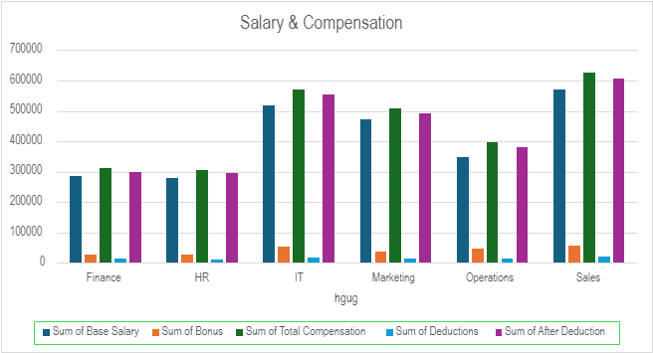
RESULTS
12

Slide 13
Conclusion
Salary and compensation analysis revealed key insights into our organization's pay practices
Excel modeling enabled data-driven decision-making and forecasting
Recommendations for optimization and improvement will:
Enhance employee satisfaction and retention
Improve budget efficiency
Inform strategic talent management decisions
Ensure market competitiveness

